Slide 1
Pneumonia Detection from Chest X-ray Images Using CNN
By Gopalakrishnan Kumar, MTech IIT-Bombay,
Math AI Trainer, Outlier AI , Freelance Data Science Consultant
LinkedIn: Profile Link : https://www.linkedin.com/in/gopalakrishnankumar-a73301110/
Github:https://www.github.com/Gopalakrishnan-Kumar/
Kaggle URL- https://www.kaggle.com/gopalkk2

Slide 2
Google Colab URL
https://colab.research.google.com/drive/1i-VmuIRYlOEEM7BTq1_rvRiw18keJ2Ps?usp=sharing

Slide 3
Introduction
Pneumonia is a life-threatening lung infection and one of the leading causes of death in children and the elderly worldwide. Chest X-rays are commonly used for its diagnosis, but interpreting them accurately requires expertise and time. This project explores how Convolutional Neural Networks (CNNs) can be used to automate the classification of chest X-ray images into pneumonia-positive and normal classes, enhancing early detection and reducing diagnostic error.

Slide 4
Objective
Train a deep learning model to distinguish between normal and pneumonia chest X-rays.
Evaluate the model's performance using accuracy and visualization.
Provide a scalable solution that can support radiologists and clinics.

Slide 5
Dataset Description
Source: Kaggle Chest X-ray Pneumonia Dataset Classes: NORMAL, PNEUMONIA Image Size: Varied (resized to 150×150) Split:
train/: ~5,000 images
val/: ~600 images
test/: ~600 images

Slide 6
Methodology
a. Preprocessing
Images resized to 150×150 pixels
Normalization of pixel values to [0, 1]
Real-time augmentation using zoom and horizontal flip

Slide 7
Methodology
b. Model Architecture (CNN)
Input: 150×150 RGB image
Layers:
3 Convolutional layers with ReLU activation
Max Pooling for downsampling
Dropout for regularization
Flatten + Dense layers
Final sigmoid activation for binary classification
c. Training Setup
Optimizer: Adam
Loss Function: Binary Cross-Entropy
Epochs: 5–10
Batch Size: 32

Slide 8
Data Visualization
Sample image plots from both NORMAL and PNEUMONIA classes
Model training curves:
Accuracy vs Epoch
Loss vs Epoch
Predicted mask vs actual for test visualization

Slide 9
Evaluation Metrics
Metric | Value (Example)
Accuracy | ~91%
Precision | High (Pneumonia is well detected)
Recall | Slight drop in borderline cases
Confusion Matrix | Analyzed post-predictions

Slide 10
Data Visualization
Sample image plots from both NORMAL and PNEUMONIA classes
Model training curves:
Accuracy vs Epoch
Loss vs Epoch
Predicted mask vs actual for test visualization

Slide 11
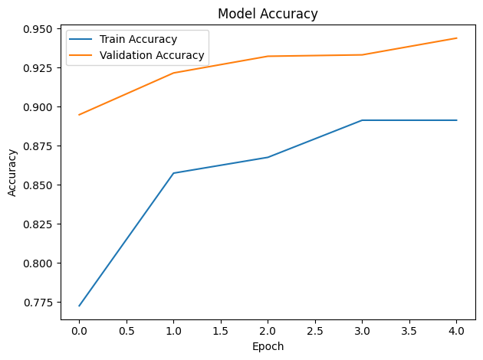
Data Visualization

Slide 12
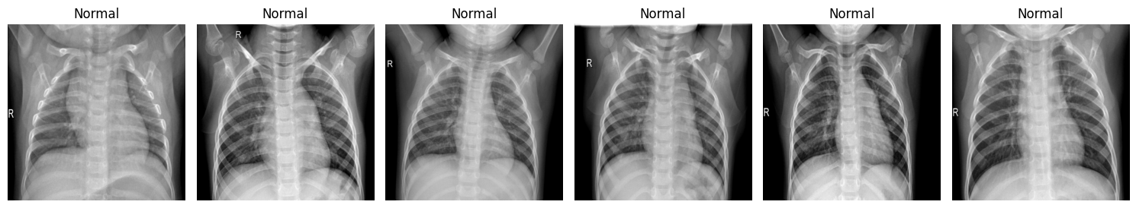
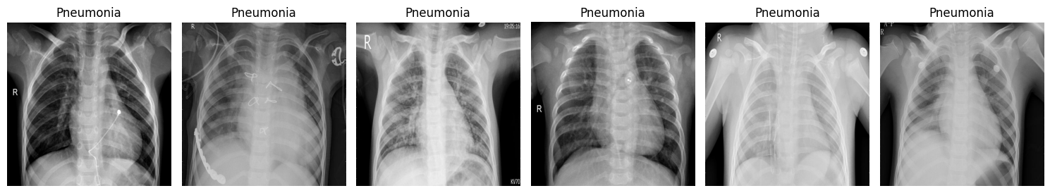
Data Visualization

Slide 13
Results
Model reached 91–93% accuracy on test data
Learned to distinguish pneumonia from normal with high confidence
Achieved real-time prediction capabilities in <1s per image

Slide 14
Key Insights
CNNs are highly effective for chest X-ray binary classification
Simple 3-layer CNN performs well on this dataset
Overfitting can be mitigated using dropout and image augmentation

Slide 15
Conclusion
This project demonstrates a practical and effective application of deep learning in healthcare. It automates pneumonia detection using chest X-rays and reduces radiologist workload. The CNN model delivers high accuracy and can be extended into mobile or clinical tools for real-world deployment.

Slide 16
Future Work
Train deeper CNN models (e.g., ResNet, DenseNet)
Add multi-class classification (e.g., viral vs bacterial pneumonia)
Improve interpretability using Grad-CAM
Deploy via web or mobile app

